Slide 1
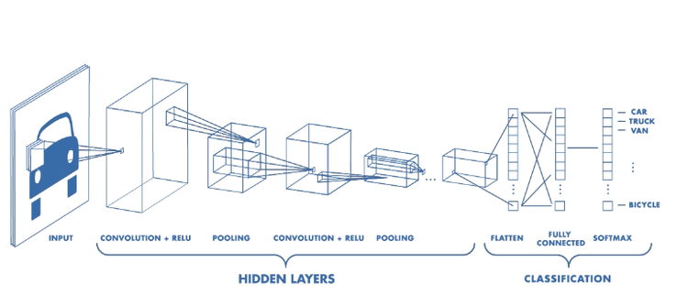
Convolutional Neural Networks

Slide 2
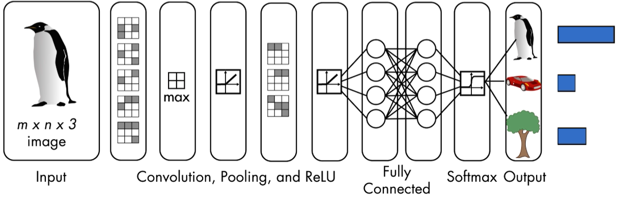
Convolutional Neural Network
Convolutional neural networks (CNNs) are a type of deep learning networks designed for applications where the input has an inherent two-dimensional structure, like an image
CNNs are made of different layers, each with individual functionalities, and are mainly used for classification:
the output layer returns the strength of the network’s prediction for each possible class
Notes:
Introduction to Convolutional neural networks

Slide 3
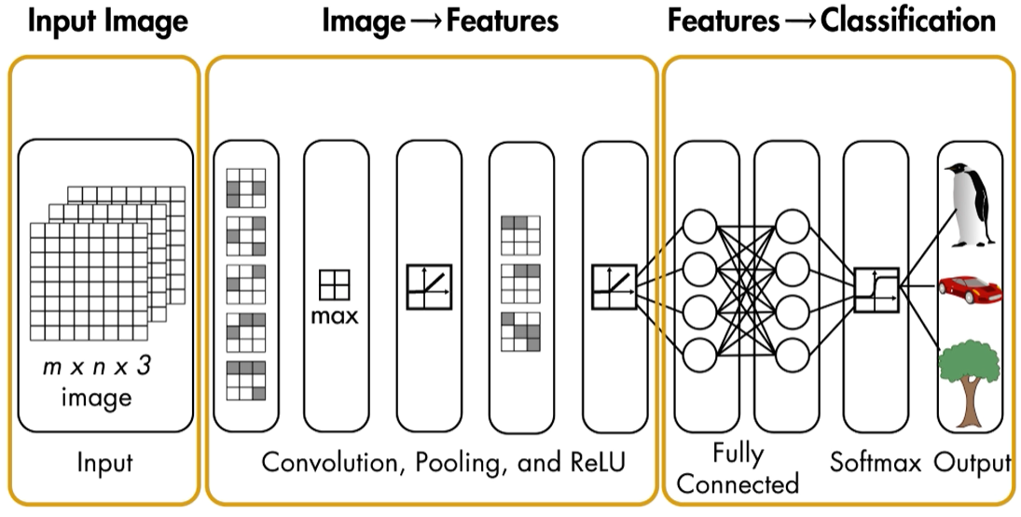
Features from the input
The first network’s layers turn the input image into a set of features that the last few fully connected layers can use to perform the classification
Each layer has a set of parameters, known as weights
The value of the weights are determined by training the network on known data:
The behavior of the network is learned from that data
CNNs autonomously learn the set of features that well fits the specific task to solve
Notes:
The aim of this slide is to highlight that CNNs consist of layers with learnable weights.
A CNN autonomously learn the set of features that well fits the specific task to solve

Slide 4
Convolutional Neural network workflow
During the training, a CNN is passed a set of images and the labels
Parameters (weights and biases) are “learned” during the training
Hyperparameters are set by the user before the training:
Initial learning rate
Number of epochs
Batch size
Data Forwarding
After the training, the CNN is passed a new (unseen) data set and the model predicts the labels (classifies the images)
Notes:
The aim of this slide is to highlight the CNN workflow.
Training a convolutional neural network involves adjusting the network parameters to match the training images. During the training a CNN learns the set of filters that extract the best features for the specific task to solve.

Slide 5
Convolutional Neural Network Architecture
The CNN architecture for a classification problem includes several layers:
Convolutional layers
Pooling layer
Batch Normalization layer
Rectified Linear Unit (ReLU) layer
Fully connected layers
Output layer
A typical architecture consists of a stack of several layers
Notes:
Introduction to the layers used to built a convolutional neural network

Slide 6
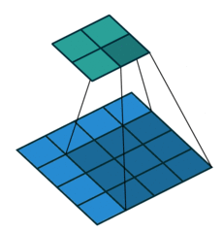
Convolutional Layer
A convolutional layer applies a sliding convolutional filter to the input
A convolutional layer consists of neurons that connect to subregions of the input images or the outputs of the previous layer:
The layer learns the features localized by these regions while scanning through an image
A convolutional neural network can consist of one or multiple convolutional layers:
The number of convolutional layers depends on the amount and complexity of the data.
Notes:
Brief introduction to convolution layer (See 2.b.a, the previous lesson)

Slide 7
Pooling Layer
The Pooling layer is responsible for reducing the spatial size of the output of its previous layer:
The aim is to decrease the computational power required to process the data through dimensionality reduction
There are two types of Pooling:
Max Pooling:
performs down-sampling by dividing the input into rectangular pooling regions, and computing the maximum of each region
Average Pooling:
performs down-sampling by dividing the input into rectangular pooling regions and computing the average values of each region
The stride is the step size for traversing the input vertically and horizontally
Max Pooling
Average Pooling
29
15
28
184
29
15
28
184
0
100
70
38
0
100
70
38
12
12
7
2
12
12
7
2
12
12
45
6
12
12
45
6
2x2 size Pooling Stride length = 2
2x2 size Pooling Stride length = 2
100
184
36
80
12
45
12
15
Notes:
The concept of pooling layer
While the dimensions are reduced the essential information is preserved. This means that the spatial information is lost (this however is not important in classification problems as we only want to know that the image shows a cat for example, it does not matter if the cat is in the middle or in the corner of the image, this information is more important in object detection)

Slide 8
Batch Normalization Layer
At each iteration of the training step, the network processes a batch of input images
The batch normalization layer normalizes each input channel across a batch:
The aim is to speed up training of convolutional neural networks and reduce the sensitivity to network initialization
The batch normalization layer is often used between convolutional layers and nonlinearities, such as Rectified Linear Unit (ReLU) layer
Notes:
The need for batch normalization layer

Slide 9
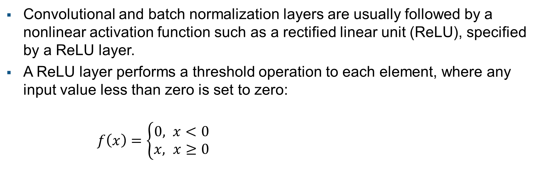
Rectified Linear Unit (ReLU) layer
Convolutional and batch normalization layers are usually followed by a nonlinear activation function such as a rectified linear unit (ReLU), specified by a ReLU layer.
A ReLU layer performs a threshold operation to each element, where any input value less than zero is set to zero:
$f\left(x\right)=\left\{\begin{aligned}0, x<0 \\ &x, x≥0\end{aligned}\right.$
f(x)
x
Notes:
The Rectified Linear Unit (ReLU) layer implements the rectified linear unit function. Since its derivative is one for input value greater than zero, ReLU is able to solve the vanishing gradient problem (See 1d - A gentle introduction to Deep Learning).

Slide 10
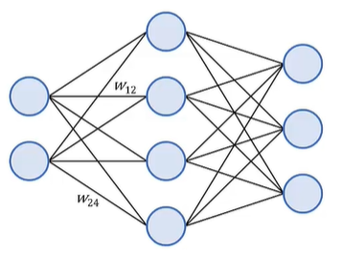
Fully connected Layer
The convolutional (and down-sampling) layers are followed by one or more fully connected layers
As the name suggests, all neurons in a fully connected layer connect to all the neurons in the previous layer
This layer learns the high level features, specific to the data set
For classification problems, the last fully connected layer combines the features to classify the images.
Notes:
The usage of fully connected layer in convolutional neural network.
Fully connected network is often referred to as Vanilla Network.
While previous layers learn low level features such as blobs, edges, shades, the fully connected layer learns data specific features such as eyes, nose, etc. if you are training on face image for example.

Slide 11
Output Layer
For classification problems, a softmax layer and then a classification layer must follow the final fully connected layer:
The softmax layer applies softmax function to its input (transforms scores into probabilities)
The Classification layer computes the cross entropy loss for multi-class classification problems with mutually exclusive classes. The classification layer takes the values from the softmax function and assigns each input to one of the classes using the cross entropy function
Notes:
The aim of this slide is to explain how the predicted class is computed.

Slide 12
Differences from Fully Connected Neural Networks
Fully connected neural networks
Convolutional Nural Networks
Feed forward Networks
Made up of neurons with learnable weights and biases
All neurons connect to all the neurons in the previous layer
Neurons in the same layer have a different set of weights
Feed forward Networks
Made up of neurons with learnable weights and biases
Each neuron is connected to only a local region of the input volume (receptive field)
Neurons in the same layers have the same set of weights (convolutional filter)
Notes:
The differences between fully connected neural networks and convolutional neural network

